Slide 1

SCSA 1502
COMPUTER NETWORKS AND DESIGN
UNIT 5 EVOLVING TECHNOLOGIES
Dr. VEDANARAYANAN.V
Assistant Professor, Department of ECE,
Sathyabama Institute of Science and Technology,
Chennai
Mr. MEGALAN LEO
Assistant Professor, Department of ECE,
Sathyabama Institute of Science and Technology,
Chennai
Notes:
vdaac

Slide 2
COURSE OBJECTIVES
To recognize the principles of the big picture of computer networks.
To understand the networking environment.
To know the importance of VPNs.
To convey the availability of tools and techniques for networking.
To discuss about evolving technologies in networks.

Slide 3
COURSE OUTCOMES
CO1 - Understand the principles of networks.
CO2 - Interpret LAN concepts and design.
CO3 - Gain knowledge in evolving technologies.
CO4 - Clearly outline the logic behind VPNs.
CO5 - Know the importance of tools and techniques in building a network.
CO6 - Understand the underlying working concepts of a real-time network.

Slide 4

EVOLVING TECHNOLOGIES
UNIT 5
Trends in data communications – Merits of xDSL technology – Preparing for cable modems - Voice and video on the LAN – Internet voice applications – Building IP PBX telephony network – Fax over IP – Videoconferencing over IP networks.

Slide 5
Trends in data communications
optical fiber
cellular digital packet data
T1 and T3
X.25 frame relay
integrated services digital network
switched multimegabit data services
asynchronous transfer mode
synchronous optical network
fiber-distributed data interface

Slide 6
Optical Fiber
More computer and telephony applications are being developed that require the bandwidth
Carriers have been installing fiber-optic cable when it can be provided at a cost that is comparable to other transport modes, such as copper
.

Slide 7
bandwidth-intensive applications such as multimedia, document imaging, and videoconferencing,
they must increase as much as possible the transmission capacity of existing twisted-pair wiring in the local loop and do so without further delay.

Slide 8
Asymmetric Digital Subscriber Line
This technology allows for the transmission of more than 6M bps over existing twisted-pair copper wiring.
suitable for any combination of services, including LAN to LAN data transfers, ISDN, and plain old telephone service (POTS).
The electronics at both ends of the ADSL compensate for line impairments, increasing the reliability of high-speed transmissions.

Slide 9
High-Bit-Rate Digital Subscriber Line
uses two full duplex pairs, each operating at 784K bps. This technology is an electronic technology for conditioning lines for heavy data usage without the use of repeater over distances of up to 12,000 feet from the central office.
. With the addition of a “doubler” technology, transmission distances can be increased even more.

Slide 10
CELLULAR DIGITAL PACKET DATA
(CDPD) is a data-over-cellular standard for providing a LAN-like service over today’s cellular voice networks.
The CDPD infrastructure uses existing cellular systems to access a backbone router network, which uses the internet protocol (IP) to transport user data.
CDPD extends client/server-based applications from the LAN environment into the wireless environment in support of mobile computer users.

Slide 11
T1 AND T3
Traditional T1, which operates at 1.544M bps
Local exchanges are now being equipped to support switched T1 for on-demand (e.g., dial-up) service.
Setup takes less than two seconds, providing a fast, efficient, and economical alternative to dedicated lines, which entail fixed monthly charges regardless of how little they are used.
T3 represents the equivalent of 28 T1 lines operating at the DS3 rate of 44.736M bps.

Slide 12
X.25
X.25 was developed before digital switching and transmission technology became available. Because networks suffered at that time from interference from noise.
store-and-forward method of data communication to ensure error-free transmission.
When errors arrive at a network node, a request for retransmission is sent to the originating node, which retains a copy of the packets until they are acknowledged.

Slide 13
FRAME RELAY
Frame relay is a packet technology that offers performance advantages over X.25 while allowing users to more easily interconnect high-speed LANs over the WAN.
protocol sensitivity, unneces_x0002_sary overhead functions, and associated processing at each network node — all characteristic of X.25 — are eliminated to obtain higher transmission rates. T
functions have been relegated to the edges of the network rather than placed at every node along a path, as in X.25, bad frames are simply discarded

Slide 14
FRAME RELAY
Allows a variable frame size to make the most efficient use of available bandwidth.
Frame relay’s variable-length frames also mesh well with the variable-length packets used in TCP/IP, OSI, and DECnet
Frame relay services are based on permanent virtual connections (PVCs) that correspond to the organization’s network nodes.
Node addresses are stored in each switching point on the network so that frames can be routed accordingly.

Slide 15
FRAME RELAY
For each PVC, the customer chooses a committed information rate (CIR) that supports the application, and the carrier bills for it accordingly.
In frame relay, a 256K bps virtual connection can handle bursts of up to 1M bps. However, too many users exceeding their CIRs at the same time creates the possibility of the network becoming congested and of frames being discarded.

Slide 16
INTEGRATED SERVICES DIGITAL NETWORK
Primary rate interface (PRI) rely on switched T1 facilities.
Of the 24 64Kbps channels, 23 are bearer channels used for voice or data applications, and the twenty-fourth D channel supports call-management functions.
ISDN automatic number identification feature has also enabled some users to build new applications that integrate the traditionally separate domains of computer databases and voice communications

Slide 17
INTEGRATED SERVICES DIGITAL NETWORK
Improved call routing:Without actually connecting the call, ISDN’s signaling channel first determines whether a PBX or automated call distributor (ACD) can handle it.
If not, the call is forwarded to a PBX or ACD at another location that can take the call.
This arrangement is useful for businesses spread across different time zones in that they can extend normal business hours. It also provides failure protection, so that if one location experiences an outage, another location can take the calls.

Slide 18
SWITCHED MULTIMEGABIT DATA SERVICES
High-speed, connectionless, cell-based service offered by the regional telephone companies.
It is used primarily for linking LANs within a metropolitan area. It offers cusomers the economic benefits of shared transmission facilities, combined with the equivalent privacy and control of dedicated networks.
SMDS is routinely offered by the regional telephone companies at access speeds between 56K bps and 34M bps

Slide 19
ASYNCHRONOUS TRANSFER MODE
known as cell relay, is a general-purpose switching method for multimedia (e.g., voice, data, image, and video).
Whereas frame relay and SMDS use variable length frames, the cell size used by ATM is fixed at 53 bytes.
This fixed size facilitates the switching of cells by hardware-based routing mechanisms, enabling operation at extremely high speeds.

Slide 20
ASYNCHRONOUS TRANSFER MODE
latency of ATM is orders-of-magnitude less than frame relay alone.
For example, on a five-node network spanning 700 miles, ATM exhibits 0.3m-second latency vs. 60m-second latency for frame relay at T1 speeds. (At T3, the latency of ATM is only 0.15m seconds.)
ATM makes for fast, reliable switching and eliminates the potential congestion problems of frame relay networks.

Slide 21
Advantages of ATM
The PCR is the maximum data rate that the connection can support without risking data loss.
Low latency,
High throughput
Scalability
Network of choice for supporting new, high-bandwidth multimedia applications, as well as legacy LAN and TCP/IP traffic.

Slide 22
SYNCHRONOUS OPTICAL NETWORK
Allows the full potential of the fiber-optic transmission medium to be realized.
Transmission rates that start at 51.84M bps and reach to 2.488G bps and make provisions for transmission rates of 13G bps.
Throughout this decade and beyond, SONET will gradually replace the proprietary T3 asynchronous networks of today

Slide 23
FIBER DISTRIBUTED DATA INTERFACE
Offer 100M bps of bandwidth that can alleviate potential bottlenecks.
Uses a token-passing scheme similar to token ring and a dual-ring fault protection scheme similar to sonet.
TPDDI offers the same speed as FDDI over ordinary twisted-pair wiring at distances of up to 100 meters (328 feet) from station to hub, which is enough to accommodate the wiring schemes of most office environments.

Slide 24
The Emerging Advantage of xDSL Technology
xDSL is capable of supporting any specific user bandwidth requirement given the local availability of copper. This is fine as long as one is the local exchange carrier (LEC), and one owns the copper

Slide 25
FLAVORS OF DSL
DSL service was introduced as ISDN in the 1980s. ISDN utilized a four-level PAM modulation (2 Binary, 1 Quaternary) “2b1Q” to reach the range of 18,000 feet.
HDSL came along in the early 1990s and . ISDN utilized a four-level PAM modulation (2 Binary, 1 Quaternary) “2b1Q” to reach the range of 18,000 feet.
HDSL is more robust than the old T1 service, which required repeaters every few hundred yards.
HDSL equipment has eliminated many of the problems associated with provisioning T1 service, which resulted in much lower rates for local T1 access.

Slide 26
ADSL service came about in the 1992/1993 timeframe as a vehicle for offering video services to the home.
Rate Adaptive Digital Subscriber Line (RADSL), came along as a means of allowing a transceiver to automatically adjust line speed to attain the highest level of speed over a given loop.
ADSL and RADSL promise to deliver rates of about 7Mb downstream with upstream links of about 1Mb; and while ADSL and RADSL are supposed to run up to 18,000 feet, to get the promised 7Mb downstream, the user would have to be very close to the serving central office (CO).
ADSL/RADSL service that ultimately offers a solution to the needs of the Small Office Home Office SOHO user.

Slide 27
SDSL ENABLES ISP SERVICES
SDSL equipment requires a physical connection to the local loop, an ISP must locate a Digital Subscriber Line Access Multiplexer (DSLAM) within 12,000 to 18,000 feet of a subscriber.
The ISP can do this by locating a DSLAM adjacent to the central office.
This arrangement gives the end user a direct link to the Internet at speeds of from 64Kbps through to 1.5Mb depending on the distance from the DSLAM

Slide 28
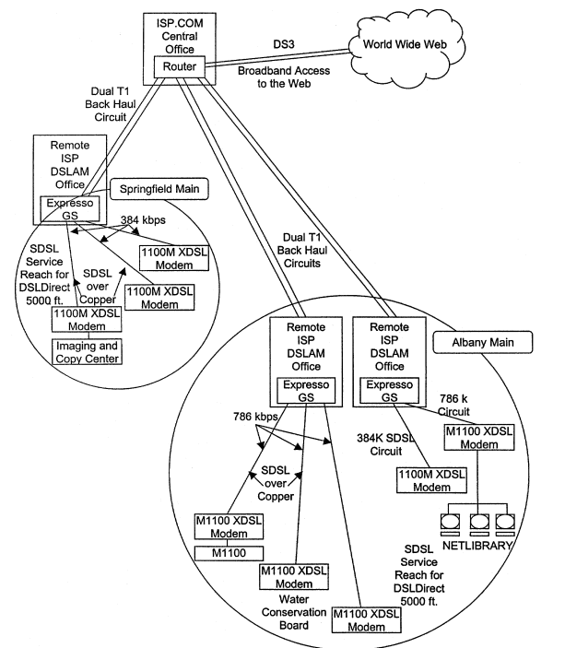

Slide 29
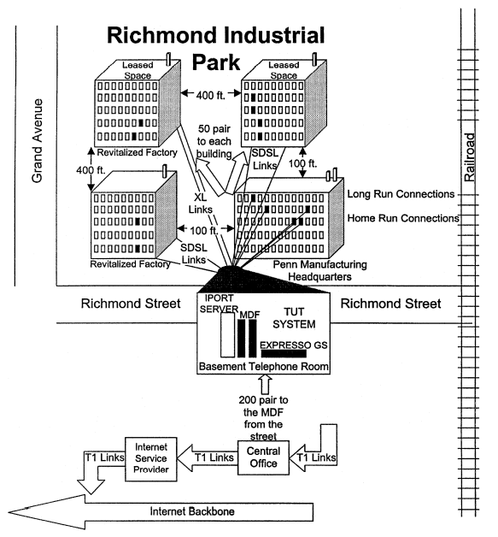
Richmond Industrial Park redeploying copper lines using DSL technology

Slide 30
DSLDirect AND ISP.COM
ISP.COM is an Eastern Internet Service Provider, serving eastern businesses with high-speed Internet access.
ISP.COM provides direct support to a number of downtown office buildings in several eastern cities.
At present, these internal connections are brought to an Ethernet switch at the DEMARC and then in turn brought back to a TUT Systems Expresso DSLAM that is connected to the ISP.COM DS3 central hub via a fiber link

Slide 31
DSLDirect
ISP has recently introduced DSLDirect for direct high-speed Internet service for small and medium sized
Using these low-cost copper circuits, the ISP is able to provide 384Kbps and 768Kbps Internet connection speeds in direct competition with other larger service providers.
The ISP service is not a bridged connection, as is the local RBOC service offering. All of the ISP DSLDirect end-user packets are shipped directly to the Internet, without being routed over several switches to the designated Internet switch.

Slide 32
Preparing for Cable Modems
Operation of conventional analog modems that are used on the switched telephone network.
This can provide the data center manager with an understanding of why analog modems’ operating rate is limited and how they may be able to overcome that operating rate limitation.

Slide 33
INTRODUCTION
A modem (modulator-demodulator) is a device that modulates an analog carrier signal to encode digital information, and also demodulates such a carrier signal to decode the transmitted information.
The goal is to produce a signal that can be transmitted easily and decoded to reproduce the original digital data.
Modems can be used over any means of transmitting analog signals, from light emitting diodes to radio.

Slide 34
Modems are generally classified by the amount of data they can send in a given unit of time, usually expressed in bits per second (bit/s, or bps).
The most familiar example is a voice band modem that turns the digital data of a personal computer into modulated electrical signals in the voice frequency range of a telephone channel.
These signals can be transmitted over telephone lines and demodulated by another modem at the receiver side to recover the digital data.

Slide 35
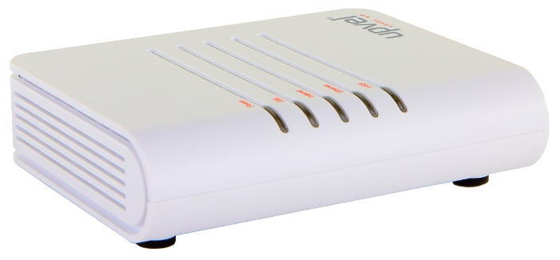
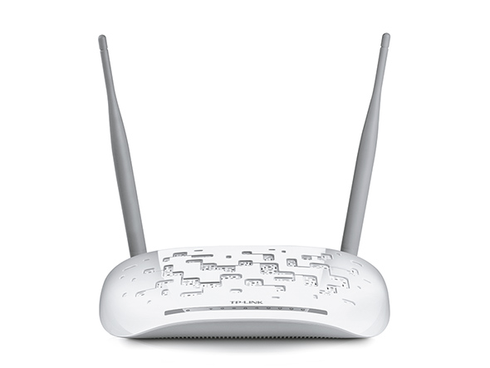
The modem (an acronym composed of the words modulator and demodulator) is a device used in communication systems for the physical interface of an information signal with the medium of its propagation, where it can not exist without adaptation.

Slide 36
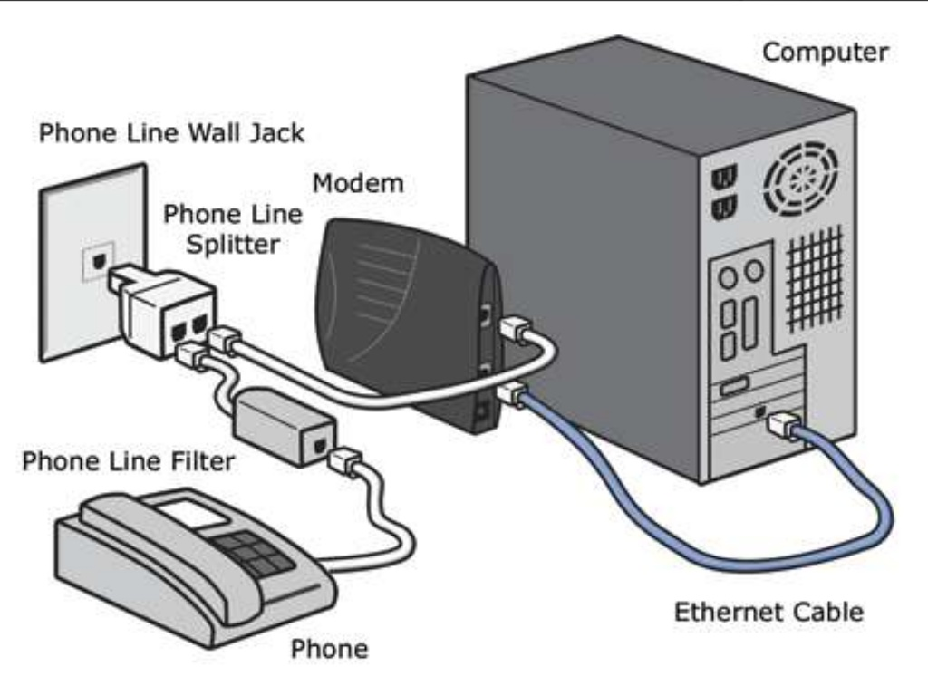

Slide 37
WHAT IS MODEM.?
Modem, short for modulator-demodulator is an electronic device that converts a computer’s digital signals into specific frequencies to travel over telephone or cable television lines. At the destination, the receiving modem demodulates the frequencies back into digital data. Computers use modems to communicate with one another over a network.

Slide 38
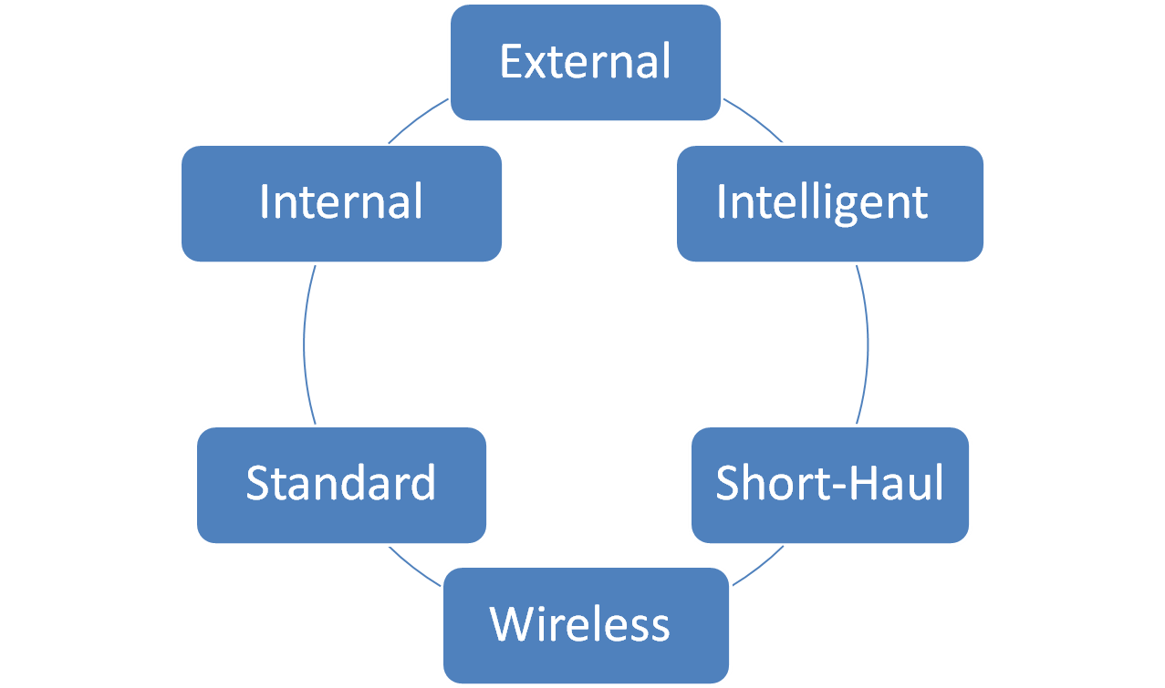
Types of computer modems

Slide 39
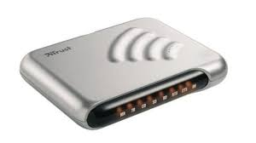
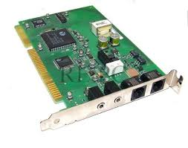
Internal Modem: An internal modem is a circuit board (a modem card) that can be added to the system unit of the computer. It takes one of the expansion slots.
External Modem: This is a modem separated from the system unit in the computer case. It is connected to the serial port of the computer by means of a cable. It is connected to the telephone wall jack by another cable.

Slide 40
Intelligent Modems: Intelligent modems are also called advanced modems. These modems can accept new instructions and then respond to the commands while transmitting data and information.
Standard Modems: Most modems used today are called standard modems. These modems are usually operated by commands entered from a microcomputer keyboard.
Short- haul modems are devices that transmit signals down the cable through any COM1 port.
Wireless Modems: Wireless modems transmit the data signals through the air instead of by using a cable. They sometimes are called a radiofrequency modem

Slide 41
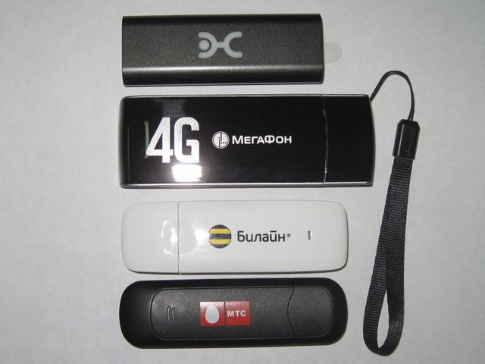
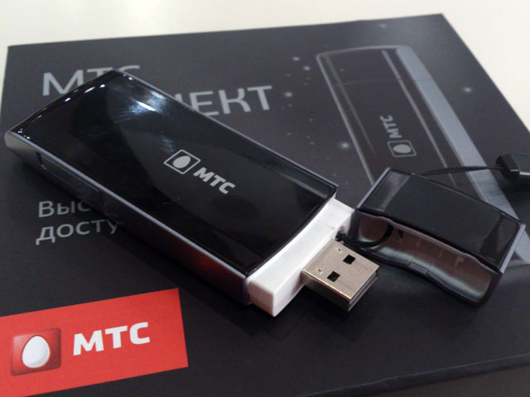
By type of network and connection Modems for telephone lines:
Modems for switched telephone lines are the most common type of modems in the XX century and 2000s. Use dial-up remote access.
ISDN - modems for digital switched telephone lines.
DSL - are used for the organization of dedicated (non-switched) lines by means of an ordinary telephone network.
Cable modems - used to exchange data on specialized cables.
Radio modems - work in the radio range, use their own frequency sets and protocols:
Wireless modems - work on the protocols of cellular communication (GPRS, EDGE, 3G, LTE) or Wi-Fi. Often have performances in the form of a USB key fob. .
Satellite modems - used to transmit data through a radio channel with retransmission via artificial satellites.
PowerLine-modems (standard HomePlug) - use the technology of transmissions

Slide 42
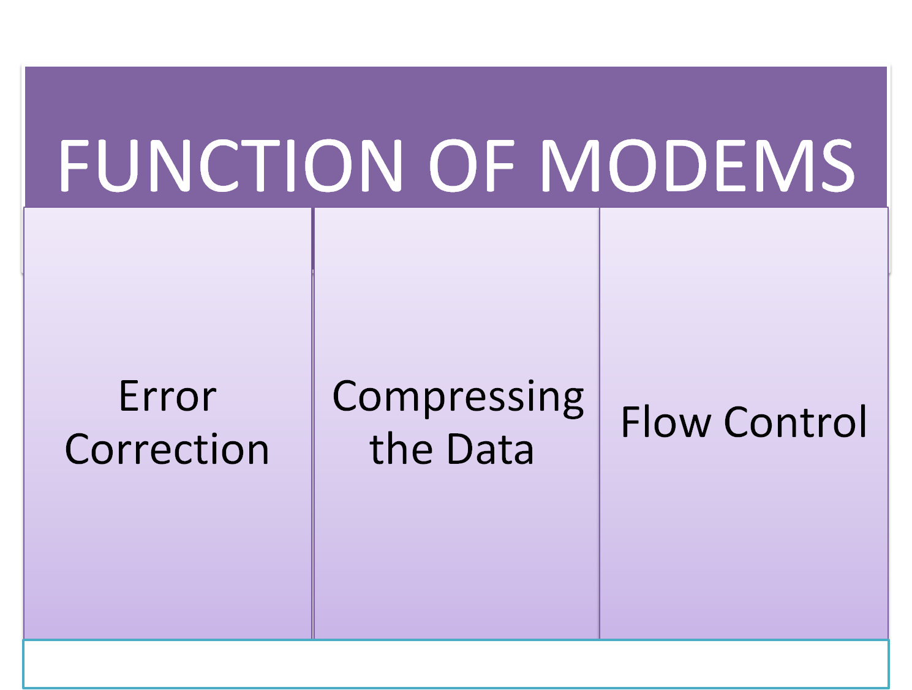

Slide 43
Modem Security
Modem security can be an issue for some people, especially if they leave their modems on for a continuous connection to the Internet. However, many modems have built-in security software to protect your home computer from invasion. Using a router will enhance your security, as will shifting to a less popular but highly secure operating system like Linux.

Slide 44
MODEM FUNDAMENTALS
A conventional analog modem-maximum operating rate- 28.8K bps and 33.6K bps
In theory, the maximum operating rate of an analog modem that has been designed for use on the switched telephone network is limited by the 4KHz bandwidth provided by the communications carrier for a switched telephone channel.

Slide 45
Nyquist theorem
In 1924, Nyquist proved that the maximum signaling rate of a device is limited to twice the available bandwidth; beyond that rate, inter-symbol interference occurs and adversely affects the transmission.
As an example, for the 4K Hz telephone channel, maximum signaling rate of a modem used to transmit on that medium is limited to 8000 baud. Baud is a term used to indicate signal changes per second.

Slide 46
QAM
uses a combination of phase and amplitude to convey the settings of a group of bits in one signal change, enabling four bits to be represented by one baud change.
This in turn enables an 8000 baud signaling rate to transport data at a rate of 32K bps when QAM is used for modulation.
with a slightly higher rate of 33.6K bps recently achieved by a few modem vendors using a modified QAM technique.
incorporation of data compression-67.2Kbps and 134.4Kbps

Slide 47
CABLE MODEMS
The key difference is the bandwidth of the channels they are designed to use.
Cable TV uses RG-11 cable for the main CATV trunk and RG-59 cable from trunk distribution points into and through residences and offices.
Both types of coaxial cable have 75 ohms impedance and support broadband transmission, which means that two or more channels separated by frequency can be simultaneously transported on the cable.

Slide 48
From Unidirectional to Bidirectional Systems
A cable TV broadcasting infrastructure uses 6M Hz channels within the bandwidth of RG-11 and RG-59 cable to transmit a TV channel.
Most CATV systems are currently unidirectional.
CATV operators begin to add bidirectional amplifiers will support transmission from subscribers in the reverse direction to conventional TV signal broadcasts.
This will enable CATV systems to support the standardized transmit frequency range of 5M Hz to 42M Hz, and receive a frequency range of 54M Hz to 550M Hz, with 6M Hz cable TV channels
By using one or more 6M Hz cable TV channels, a cable modem obtains the use of a bandwidth that is 1500 times greater (6M Hz/4K Hz) than that provided by a voice channel on the switched telephone network.
modem can support a signaling rate of twice the bandwidth, or 12M baud, on one TV channel, based upon the Nyquist theorem, before the occurrence of inter-symbol interference.

Slide 49
Zenith Network Cable Modem System
operates on 6M Hz channels at 4M bps to the subscriber, using a special filtering technique to prevent data channels from interfering with adjacent information.
The uplink or return data rate occurs at 500K bps.
Modem modulation is biphase shift key (BPSK), which means that two bits (bi) are encoded in each phase change, and the modem’s phase changes are shifted in phase from one to another.

Slide 50
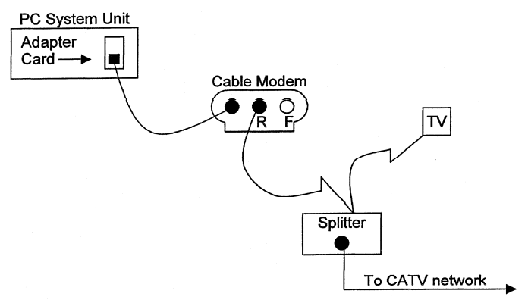
Zenith Network Cable Modem System
R- reverse cable connector designed for networks that use a single coaxial cable.
“F,” a forward cable connector that would be used if the modem were connected to a cable system that uses two cables.

Slide 51
A High-Speed Cable Modem Architecture
This architecture is based on the use of 16-VSB (vestigial sideband), a technique developed by Zenith as part of the organization’s high-definition research, as well as the 256 quadrature amplitude modulation technology.
Zenith modem architecture can support data rates up to 40M bps on a 6M Hz cable channel.

Slide 52
Internet Voice Applications
The Evolution
Current Audio Products and Applications
AUDIO broadcast.
Group conferencing.
Telephony

Slide 53
THE WORKINGS OF INTERNET VOICE TECHNOLOGIES
Internet audio and telephony applications employ efficient software_x0002_driven codecs on a personal computer or workstation to digitize and packetize voice information for transport via internetwork protocols such as SLIP, PPP, TOP, or UDP. and speakers) and analog-digital conversion.
These applications use the computer’s multimedia hardware for input/output devices (e.g., microphones

Slide 54
Delay
Delay is only significant in two-way communications. Delay is accounted for by buffering a certain amount of voice information in order to compensate for variations in network transit time between callers.
While this actually adds slightly to the overall delay perceived by the user, it is a necessary acknowledgment of the random, unpredictable delay present in today’s Internet

Slide 55
One-Way Audio Broadcasts
Applications- radio stations, news services, or corporations
A centralized server digitizes the audio and either transmits it in real time to Internet-attached users, or stores the compressed audio on the server.
Later access a compressed audio file on the server.
Users are not required to download the file to their local workstation

Slide 56
Two-Way Conferences
Two-way conferencing applications are very popular among noncommercial users. A modified chat-server implementation is used to connect multiple users. Half-duplex communication is the norm, but some available applications allow limited whiteboard and collaborative computing capabilities

Slide 57
USAGE ISSUES AND IMPEDIMENTS
Support for Full-Duplex Operation
Interoperability Standards
IP Addresses
Unpredictable Nature of the Internet
Multiplatform Support

Slide 58
FUTURE DIRECTIONS
Multitasking and collaborative applications will benefit from increased platform capacity and connection speed as well.
Applications that employ images, video, whiteboarding, and console-sharing may be performed in real-time

Slide 59
ALL-IMPORTANT INFRASTRUCTURE ISSUES
Quality of Service Is Everything
Reliability.
Performance.
Predictability
Fairness.
Accessibility.
Becoming as Reliable as the Telephone
Redundancy

Slide 60
Responsibilities of Service Providers
Infrastructure development
Performance Metrics — Quantifying “Perception.”
Predictability — Key to a Universal Service.
Fairness — Meeting Guaranteed QOS Levels
Accessibility to a Broad User Base

Slide 61
Building an IP PBX Telephony Network
Yesterday’s : users to talk together, and to talk out to the PSTN (public switched telephone network).
PBX (premise branch exchange) manufacturers fulfilled this need by installing a mainframe computer into the enterprise and connecting a proprietary line card interface to either analog phones or proprietary digital phones. The connection out to the PSTN was established through a trunk interface card.

Slide 62
Today’s PC-based PBX similarly fulfills a need.
Same as the mainframe PBX architecture. The big difference is the use of relatively inexpensive PCs instead of hefty mainframe computers.
The third generation, tomorrow’s PBX, is the IP (Internet Protocol)- based PBX.
Instead of using a line interface card and circuit-switched card, it uses the TCP/IP network switching voice packets through an Ethernet, ATM, frame relay, ISDN, or whatever satisfactorily carries TCP/IP.

Slide 63
THE IP-PBX
Voice traffic is digitized and compressed, placed into data packets, and transmitted across the packet network directly between the stations or WAN interfaces.
End stations communicate with a call control server only when a call processing function, such as transferring a call, creating a conference call, or sending a call to voice mail, is required or requested

Slide 64
Standards and the IP PBX
ITU (International Telecommunications Union) Standards (H.323 and T.120) that define how data equipment works in a data environment and define the signaling, call control, and audio compression for packet delivery of voice and video communications on IP networks.
Without these standards in place and strictly followed, interoperability would not be possible.

Slide 65
Components
An IP PBX requires three components:
Desktop telephone,
Call manager software
WAN/IP gateway.
These three components are attached to existing LAN/WAN infrastructure.

Slide 66
The Desktop Telephone
Users have two desktop phone choices:
An IP ethernet phone that plugs directly into an ethernet jack
Handsets or headsets that plug into their PC

Slide 67
The Call Manager
Provides the network intelligence to enable simple-to-use and feature-rich IP communications.
Designed to work seamlessly with existing telephony systems (pbx or centrex) or can provide full pbx functionality on its own.
Deployed as a single ip pbx in a single office, or as a single ip pbx with multiple geographically dispersed users.
Administrators can create a truly virtual campus environment

Slide 68
The Gateway
IP-based telephony systems today need to connect to the PSTN and the existing PBX.
Gateways are specifically designed to convert voice from the packet domain to the circuit-switched domain.
The gateway converts packetized voice to a format that can be accepted by the PSTN.
Provide a type of conversion called transcoding.
Gateways also pass signaling information.

Slide 69
Configurations and Applications
Instead of a circuit switch matrix to make connections, the IP PBX uses LAN bandwidth to make voice connections.
voice traffic does not pass through a central server or call manager. The call manager only performs signaling to set up and manage call states. Therefore, it can handle a large number of calls with fewer restrictions or limitations
In addition, because of the scalability of LAN architectures, the IP PBX can scale linearly from one port to thousands of ports.

Slide 70
IP Telephony off an Existing PBX
Extends the existing PBX within the campus using the IP network as transport.
The ip pbx connects to the pbx using either an analog or digital gateway, depending on the expectations of voice traffic and the number of users.
The call manager software runs on an NT server in the data center.
Allows a business, enterprise, university, or other large organization to extend normal telephony services using the existing IP Lan

Slide 71
Remote Offices over an IP Network
The call manager can remain on the central site, or a secondary call manager can be deployed at the remote location.
Companies with multiple sites can now easily install full telephony systems while leveraging the IP data network already in place.

Slide 72
Network Deployment
Similar to the previous configurations, except the call manager and the gateway are located in the WAN.
On premise would be IP phones and possibly a smaller analog gateway for local calling and backup, in case the IP link to the network is unavailable.
In addition to local and long-distance calling, provide traditional services like voice mail and call center services with the applications residing either at the remote location or in the network.

Slide 73
PRACTICAL ADVANTAGES OF THE IP PBX
Cost
Total cost of ownership
Maintenance and configuration are simpler and easier
Support
Extensible
Capacity

Slide 74
Payoffs
Long-distance charge savings
Data and voice convergence
Cutting acquisition and operating costs
Administration costs.

Slide 75
Fax over IP
Preferred for immediate hardcopy transmission of urgent documents and documents under review, where handwritten comments must be passed along
Broadcast Fax-Most broadcast faxers are business organizations that need to send the same message to a large constituency, or to a smaller but very important one.

Slide 76
Advantages
The PC is easier to use, and more convenient than a fax machine.
It is faster: no trip to the fax machine, redials, etc
Inbox users never miss a fax, retrieving their faxes like e-mail or as e-mail attachments
Inbox faxes are private and secure, and easily previewed on the PC.
Performing broadcast faxing easily from the desktop eliminates service bureau charges.
It automatically captures and reports online status of faxes.
Saves money on transmission costs

Slide 77
Videoconferencing over IP Networks
When a video camera and microphone pick up real-life events, the imagery and sound can be turned into digital formats for communications between Properly enabled end points over local or wide area networks.
Compressed in real time, the data streams over a network in such a way that frames of video can be reconstructed and synchronized with audio with the least end-to-end delay

Slide 78
Quantitative Quality of Service Parameters
End-to-end quality of service (QoS) in videoconferencing and visual collaboration is defined as the level of satisfaction a user has with a given session.
It is a function of many independent and interdependent factors (e.g., window size, processor speed, network bandwidth), which together influence frame rate, bit depth, image clarity and resolution, audio clarity, lip synchronization, and latency

Slide 79
Video factors include
Bit depth (number of colors)
Resolution (size of the image being captured, compressed, transmitted, and decompressed)
Q factor (sharpness of edges in any given frame)
Smoothing
Frame rate (frames per second

Slide 80
Audio factors include
Sampling rate
Mono and stereo sound
Bit rate
Data factors include
Quantity of data
Frequency of transmissions
Latency of transmission

